Slide 1

Toward Building Helpful Language Models
Daniel Khashabi
Notes:
Thank you for having me! It's an honor to be here!

Slide 2
Please don’t hesitate to pause me and ask questions.

Slide 3
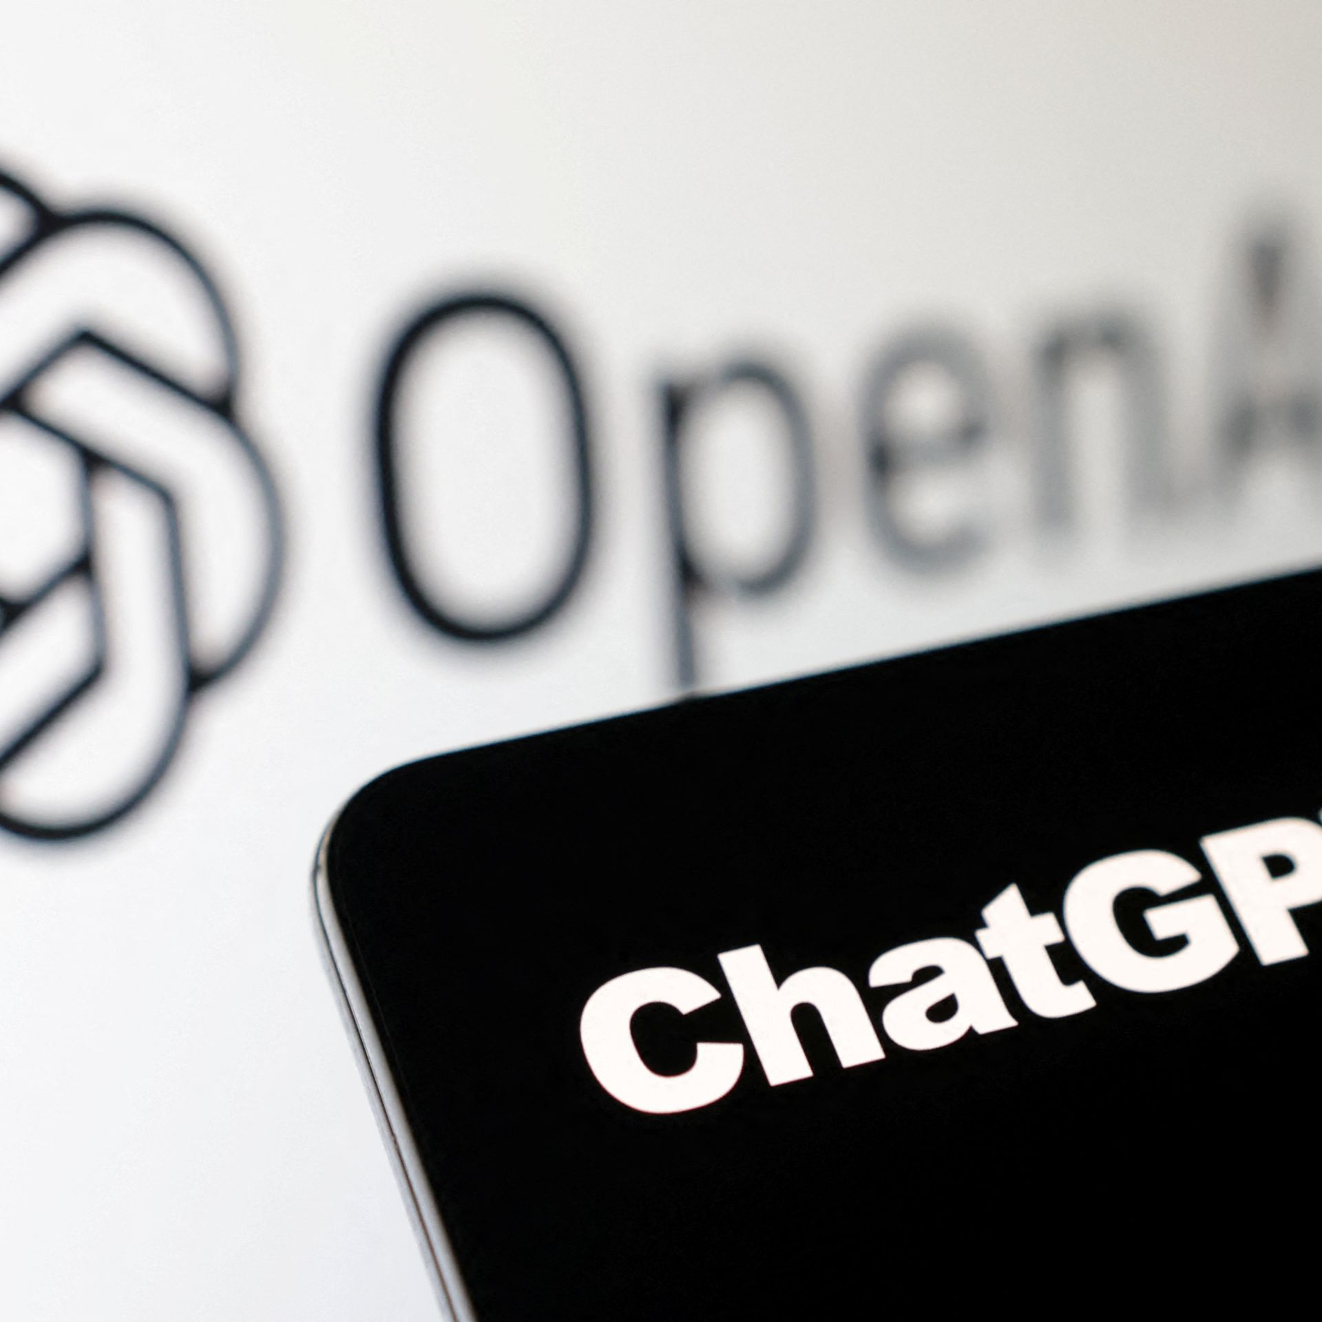
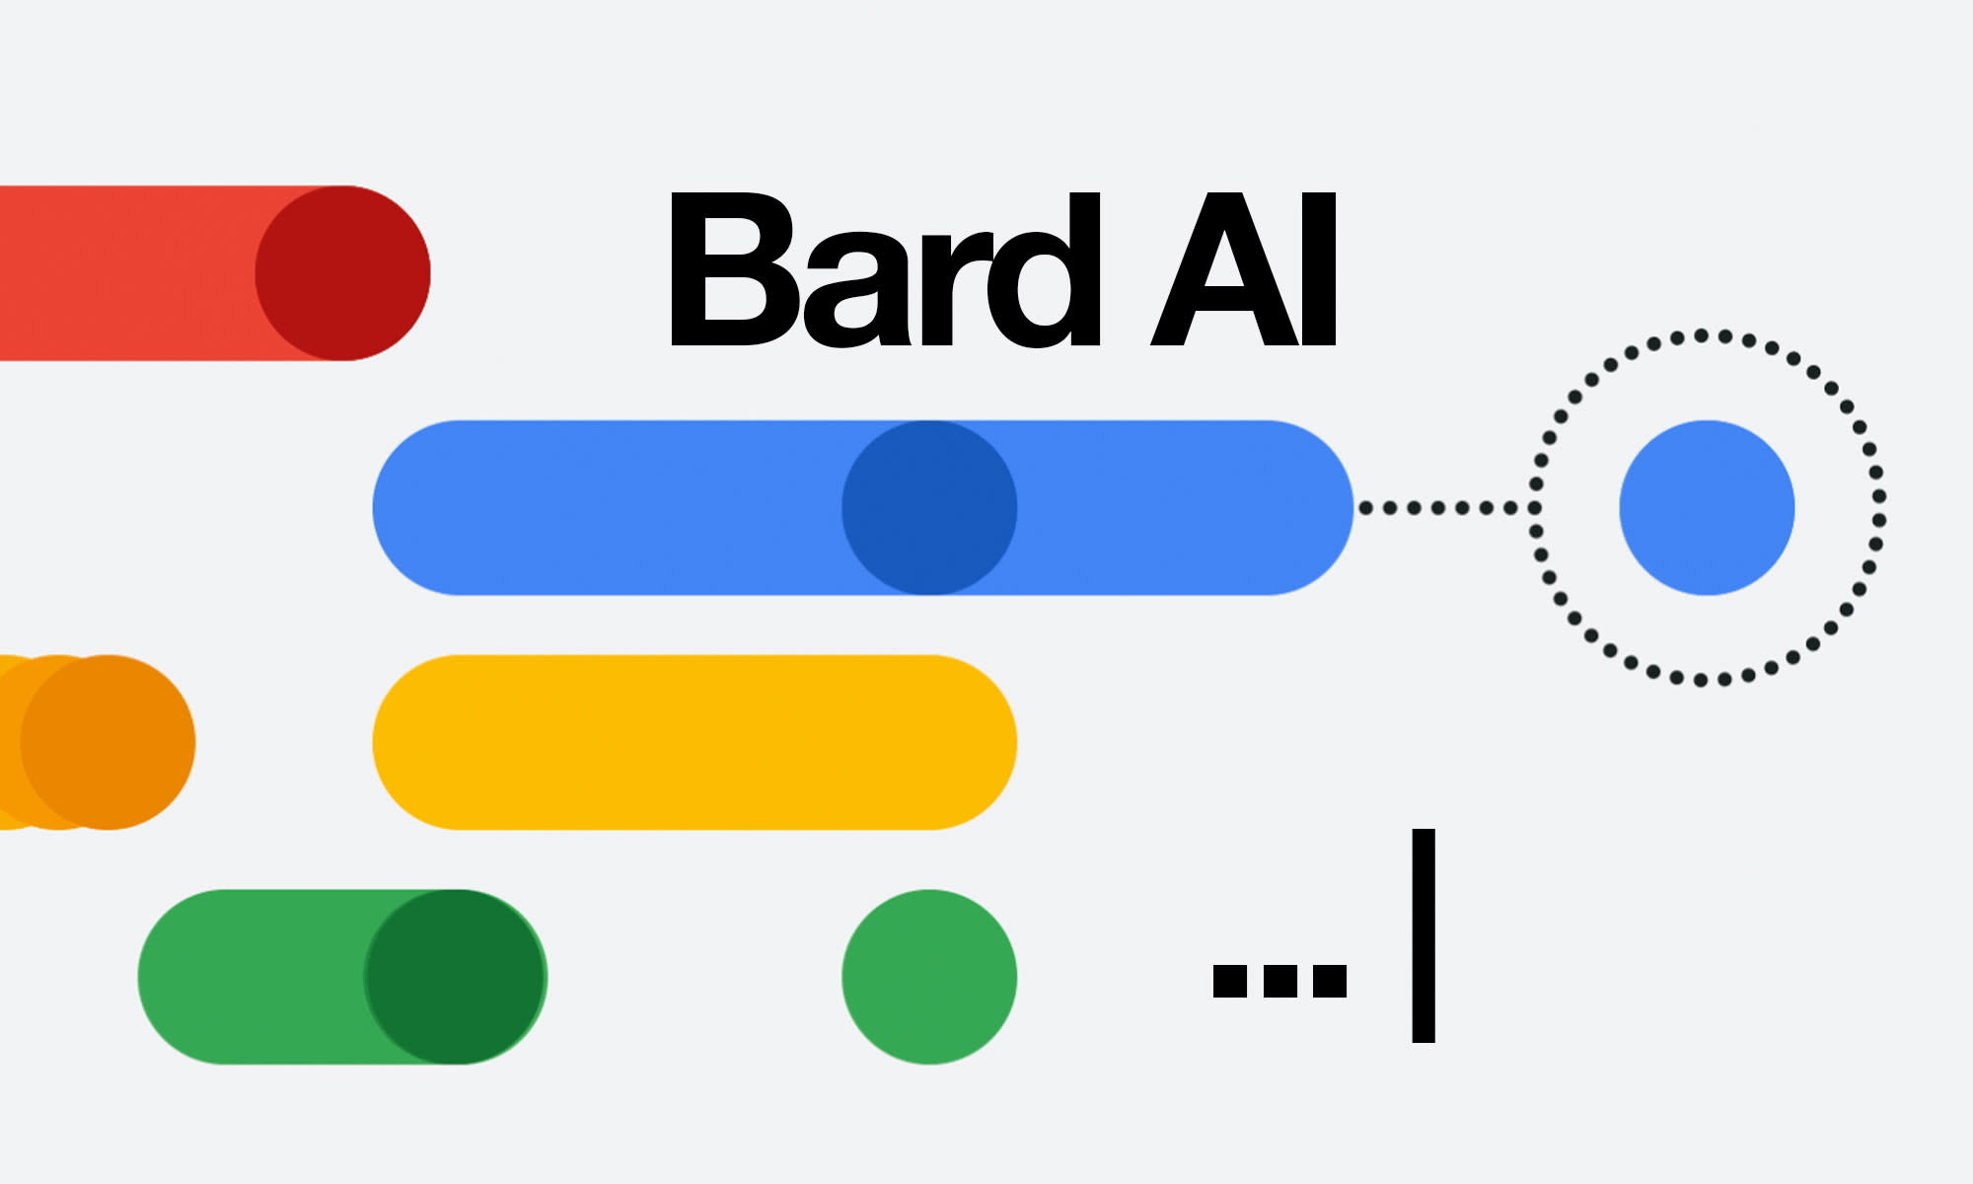


The overexcitement
Notes:
We all remember what happened 6 months ago. Chatbots released almost on weekly basis and so much excitement about AI.

Slide 4

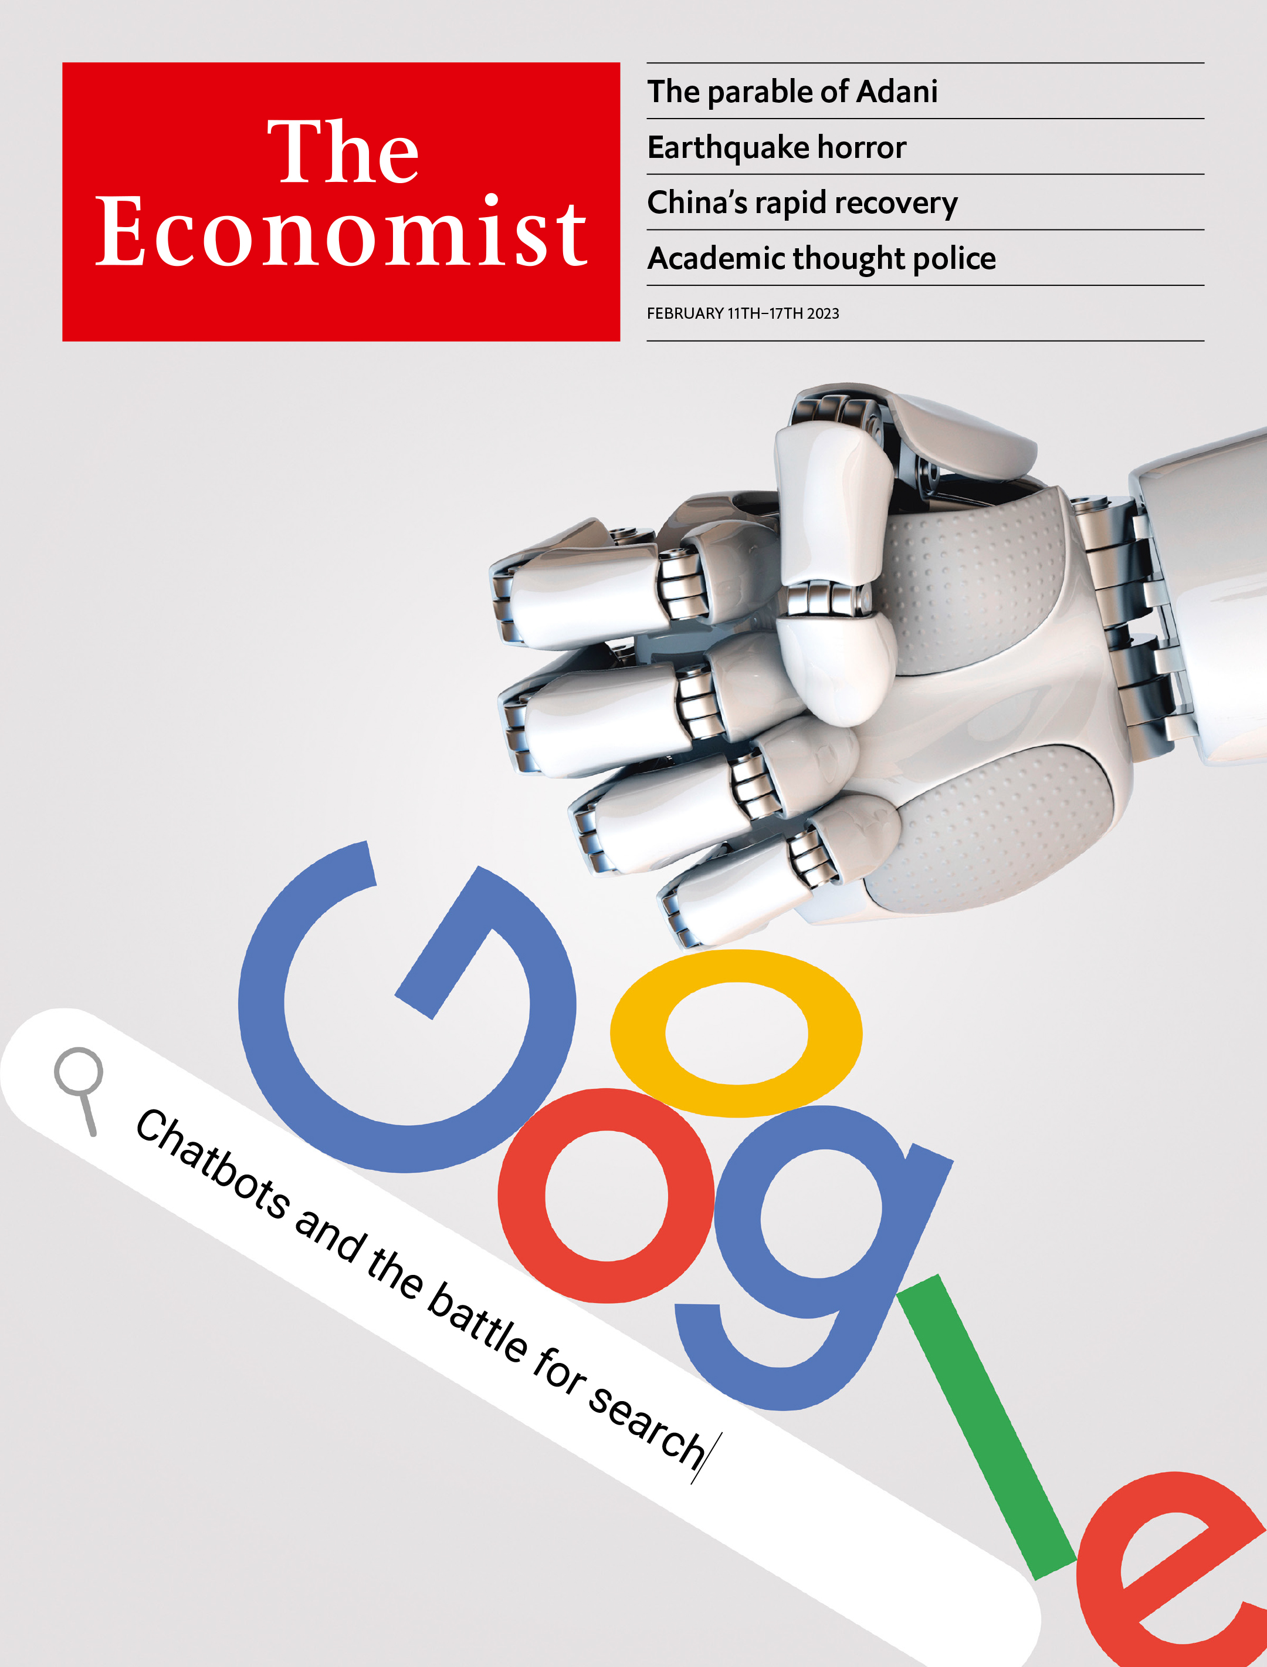
The overexcitement
Notes:
And some people on Twitter were predicting that the life of scientific research fields like NLP are over.
And some that predicted that the end of Google is near as this technology is going to transform and takeover everything with ease.

Slide 5

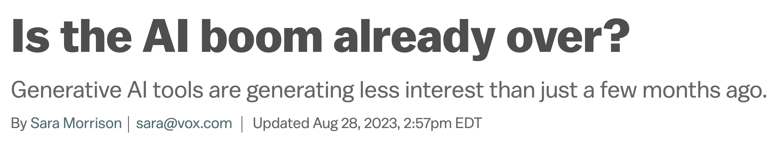

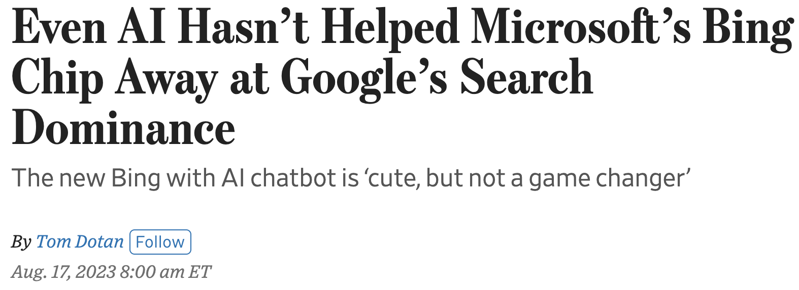
The cool
Notes:
Six months passed, and now and all that excitement is cooling off.
Now we keep seeing headlines like these that are clearly doubting the impact that was predicted for AI just 6 months ago.

Slide 6
What happened?
There is no doubt that progress was/is made.
We underestimated the difficulty of building a robust, generalizable interactive system.
There are key issues that limit broad applicability of our technology.
Notes:
So what happened?
No doubt that …
However, we under-estimated what it takes to build a robust

Slide 7
To name a few reasons …
They’re likely not cost-efficient.
Their compute cost, human annotation cost, etc.
We do not fully understand their failure modes.
They generate fabricated statements.
They creates concerns about their safe deployment.
They cannot reliably interact with the [physical] world.
We still don’t have reliable personal assistants.
They’re not helpful!
Notes:
And there are many other weaknesses that you can identify in these models that has led to this reality-check moment.
If I want to summarize all these, I’d say that these models are not yet “helpful”.
- They often overgenerate things that I don’t care about. - They regularly ignore things that I care about. And overall they’re like a sloppy apprentice that doesn’t know you that well.
This is particularly important if you want to build AI systems that have humans in their loop.

Slide 8

Calibrated uncertainties
Helpful
Consistent
Transparent
Interact w/ world
Efficient
Notes:
So overall, in the future that I hope AI progresses toward, “helpfulness” has a special place --- as it is a core tenet of building effective AI-machine interactive systems.
And pretty much any other desirable adjective emanates from from “helpfulness”.

Slide 9
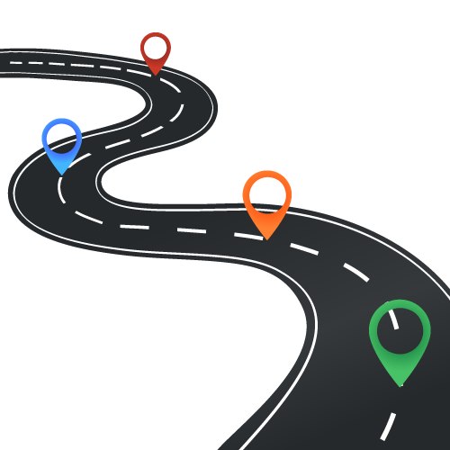
Today
Efficient Alignment
Mitigating hallucination
Wang et al. 2023
[ACL 2023]
Weller et al. 2023 [under review]
Notes:
I must confess, in none of these projects we study

Slide 10
Today
Efficient Alignment
Mitigating hallucination
Wang et al. 2023
[ACL 2023]
Weller et al. 2023 [under review]
Notes:
I must confess, in none of these projects we study

Slide 11
Language Models
Background
Input
text
LM
Output
text
[Bengio et al. ‘04, Peters et al. ‘18, Raffel et al. ‘20, Brown et al. ’20, many others]
Notes:
First let me start with a little bit of background, just to make sure that we're all on the same page.
The hero of the day, language models

Slide 12
Language Models
Background
0.2
-0.4
0.1
0.0
-0.5
Input
text
Output
text
[Bengio et al. ‘04, Peters et al. ‘18, Raffel et al. ‘20, Brown et al. ’20, many others]
Notes:
They’re compression engines, that are trained to denoise their input.

Slide 13
Language Models
Background
Johns Hopkins University is in _______.
LM
Baltimore
Simple facts
[Bengio et al. ‘04, Peters et al. ‘18, Raffel et al. ‘20, Brown et al. ’20, many others]

Slide 14
Language Modeling ≠ Following User Intents
Background
Explain gravity to a 6-year-old.
Explain black-holes to a 6-year-old.
Explain big bang to a 6-year-old.
….
Explain ”space elevators” to a 6-year-old.
LM
LMs are not “aligned” with user intents [Ouyang et al., 2022].
[Training language models to follow instructions with human feedback, Ouyang et al. 2022]
Notes:
If you ask it to ....
... they may generate text that, in their lens, is the best continuation to their to this question.

Slide 15
How do we “align” LMs with our articulated intents?
Background

Slide 16
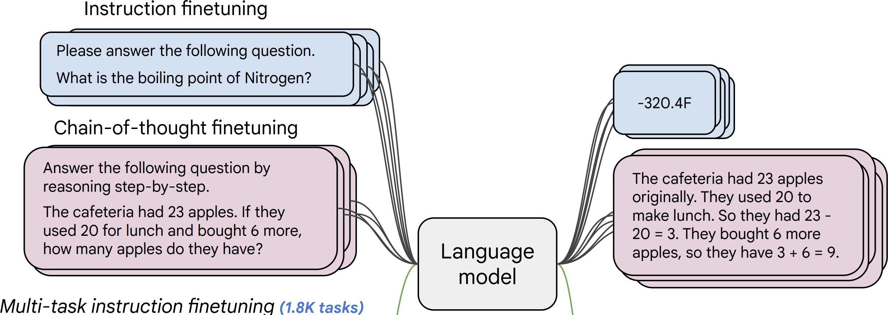
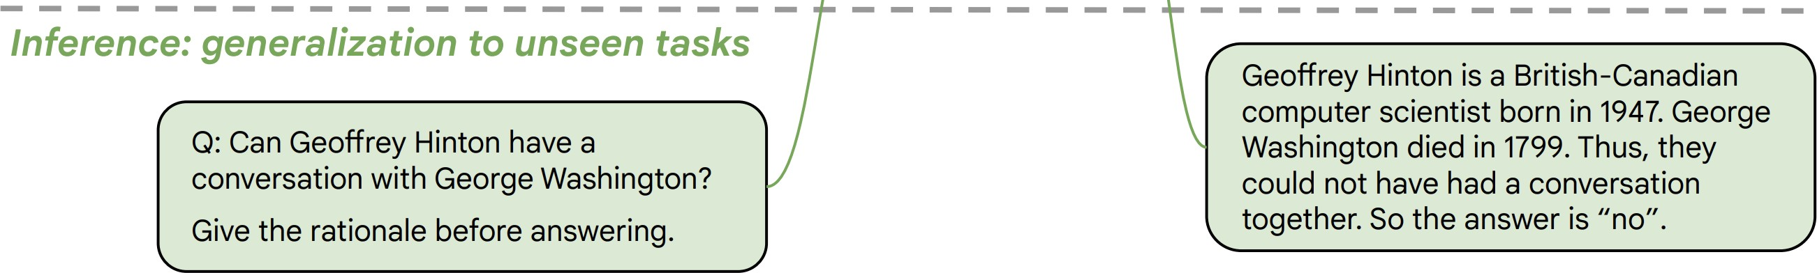
Approach 1: Behavior Cloning (Supervised Learning)
Background
Collect examples of (instruction, output) pairs across many tasks and finetune an LM
2. Evaluate LM on unseen tasks
LM
[McCann et al., 2019, Weller et al. 2020. Mishra et al. 2021; Wang et al. 2022, Sanh et al. 2022; Wei et al., 2022, Chung et al. 2022, many others ]

Slide 17
Approach 1: Behavior Cloning (Supervised Learning)
Background
Incentivizes word-by-word rote learning => limits creativity
=> The resulting models’ generality/creativity is bounded by that of their supervision data.
LM
[McCann et al., 2019, Weller et al. 2020. Mishra et al. 2021; Wang et al. 2022, Sanh et al. 2022; Wei et al., 2022, Chung et al. 2022, many others ]
Notes:
While ”behavior cloning” is a great starting point for enable models to follow human instructions, ....

Slide 18
Approach 2: RL w/ Ranking Feedback (RLHF)
Background
1. Reward Learning
2. Policy Gradient
R
It is like any typical elevator, but it goes to space. …
👍
👎
Explain ”space elevators” to a 6-year-old.
LM
👩
Explain gravity to a 6-year-old. …
Explain ”space elevators” to a 6-year-old.
LM
It is basically ….
R
[Christiano et al. 2017; Stiennon et al. 2020; Ouyang et al., 2022]
Notes:
....
- RL is much harder than supervised training for several reasons.
- The signal is weak: which parts of the answer are good and which are bad? A lot of technical works in RL attempts to solve this problem,
- Which is my LM here is initialized from a model that is already behavior-cloned.
- However, it is generally known to lead to more creative outputs.

Slide 19
Putting All-together: ChatGPT Recipe 👨‍🍳
Background
Pre-train
Align (instruct-tune)
Align (RLHF)
Notes:
Putting all these together, we get this recipe for building our ChatGPT in our kitchens….

Slide 20
Pre-train
Align (instruct-tune)
Align (RLHF)
There is misalignment between human expectation vs. pre-trained models
This forces LLMs generate outputs that are not frequently observed in pre-training — teaching them to be hypocritic.
Human feedback for aligning LLMs is costly.
Obtaining diverse and quality is quite difficult – not easy to crowdsource.
Notes:
… Just to be clear, there is no empirical evidence on the 2nd point I made here yet. All intuition and hence, no citation.

Slide 21
Can LMs Help with Generating Instruction Data?
Idea: we can bootstrap “instruction” from off-the-shelf LMs.
Pretraining
(GPT3*: 499 Billion tokens)
LLMs should know a lot of tasks!
Notes:
To study this question, my colleagues and I decided to entertain an experiment: suppose we want to build the best generalist agent, only given a vanilla language model. If all that you have is an LM, how far can you go?
Back to the original motivation: All that you're given is a language model and we want to build the best generalist agent based on this given language model how can we go about that.
Obviously, “there's no free lunch” – it's impossible to “pull cards out of thin air” – you need to make some assumptions to make the problem well-defined.

Slide 22





Self-Instruct: Aligning Language Models w/ Self-Generated Instructions
Yizhong Wang, Yeganeh Kordi, Swaroop Mishra, Alisa Liu,
Noah A. Smith, Daniel Khashabi, Hannaneh Hajishirzi
https://arxiv.org/abs/2212.10560

Slide 23
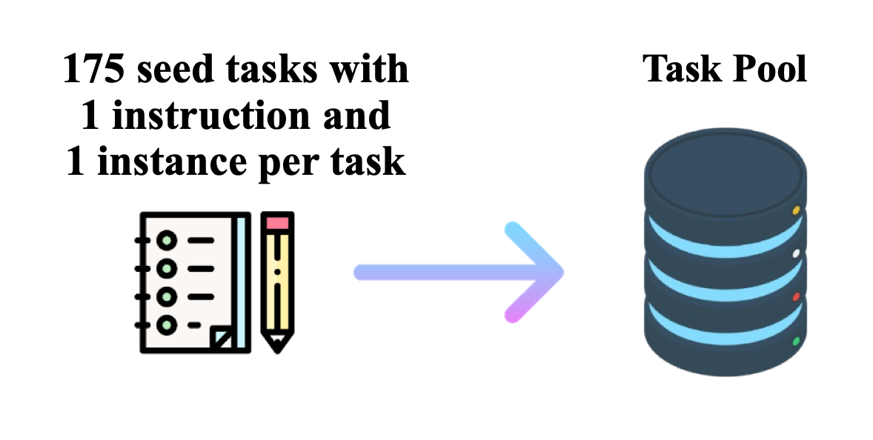
Get humans to write ”seed” tasks ✍️
I am planning a 7-day trip to Seattle. Can you make a detailed plan for me?
Is there anything I can eat for breakfast that doesn’t include eggs, yet includes protein and has roughly 700-100 calories?
Given a set of numbers find all possible subsets that sum to a given number.
Give me a phrase that I can use to express I am very happy.
175 seed tasks

Slide 24
Put them your task bank 📦
I am planning a 7-day trip to Seattle. Can you make a detailed plan for me?
Is there anything I can eat for breakfast that doesn’t include eggs, yet includes protein and has roughly 700-100 calories?
Given a set of numbers find all possible subsets that sum to a given number.
Give me a phrase that I can use to express I am very happy.
175 seed tasks
task pool

Slide 25
Sample and get LLM to expand it
I am planning a 7-day trip to Seattle. Can you make a detailed plan for me?
Is there anything I can eat for breakfast that doesn’t include eggs, yet includes protein and has roughly 700-100 calories?
Given a set of numbers find all possible subsets that sum to a given number.
Give me a phrase that I can use to express I am very happy.
LM
Pre-trained, but not aligned yet
Create a list of 10 African countries and their capital city?
Looking for a job, but it’s difficult for me to find one. Can you help me?
Write a Python program that tells if a given string contains anagrams.
175 seed tasks
task pool
📝
LM suggests new tasks

Slide 26
Get LLM to answers the new tasks
Task: Convert the following temperature from Celsius to Fahrenheit.
Input: 4 °C
Output: 39.2 °F
Task: Write a Python program that tells if a given string contains anagrams.
LM
Pre-trained, but not aligned yet
Input: -
Output: def isAnagram(str1, str2): ...
175 seed tasks
task pool
📝
📝
LM suggests new tasks
LM suggests answers

Slide 27
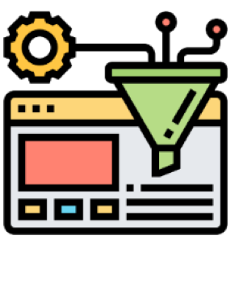
Filter tasks
Drop tasks if LM assigns low probability to them.
Drop tasks if they have a high overlap with one of the existing tasks in the task pool.
Otherwise, common tasks become more common — tyranny of majority.
175 seed tasks
task pool
LM suggests answers
📝
📝
LM suggests new tasks
LM suggests answers
filter out if not novel or confident

Slide 28
Close the loop
Add the filtered tasks to the task pool.
Iterate this process (generate, filter, add) until yield is near zero.
Our setup:
We used GPT3 (“davinci” engine, pre-trained but not aligned).
We generated 52K tasks/instructions and 82K instances.
API cost ~$600
175 seed tasks
task pool
LM suggests answers
📝
📝
LM suggests new tasks
LM suggests answers
filter out if not novel or confident

Slide 29
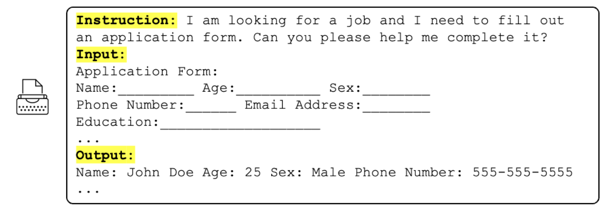
Example Tasks Generated by GPT3 (before RLHF)
[Self-Instruct: Aligning Language Model with Self-Generated Instructions, Wang et al. 2022]

Slide 30
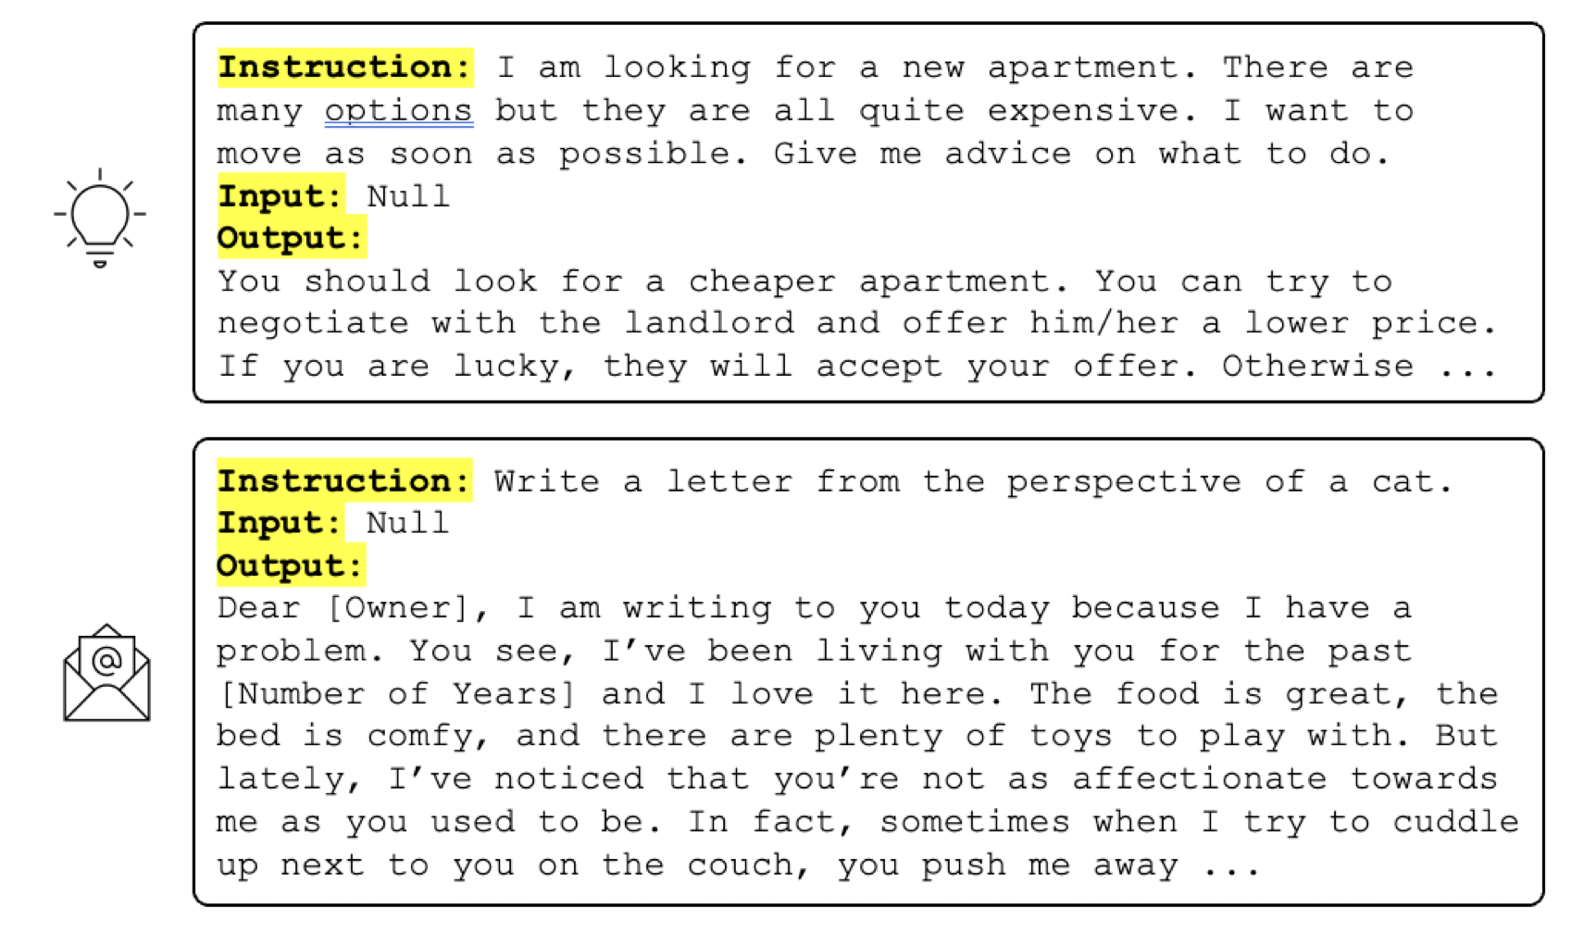
Example Tasks Generated by GPT3 (before RLHF)
[Self-Instruct: Aligning Language Model with Self-Generated Instructions, Wang et al. 2022]
Notes:
Now I don’t know who will find this useful, but it is there in the resulting data.
Hope some futuristic cats will benefit from this.

Slide 31
Example Tasks Generated by GPT3 (before RLHF)
[Self-Instruct: Aligning Language Model with Self-Generated Instructions, Wang et al. 2022]

Slide 32
How Accurate is This Data?
200 random instructions are sampled for quality check
[Self-Instruct: Aligning Language Model with Self-Generated Instructions, Wang et al. 2023]

Slide 33
Self-Instructing GPT3
Generate:
GPT3 (“davinci” engine).
We generated 52K instructions and 82K instances.
API cost ~$600
Align:
We finetuned GPT3 with this data via OpenAI API (2 epochs). **
API cost: ~$338 for finetuning
(** OpenAI training API is unclear about how it works, or how the parameters are updated.)
[Self-Instruct: Aligning Language Model with Self-Generated Instructions, Wang et al. 2023]

Slide 34
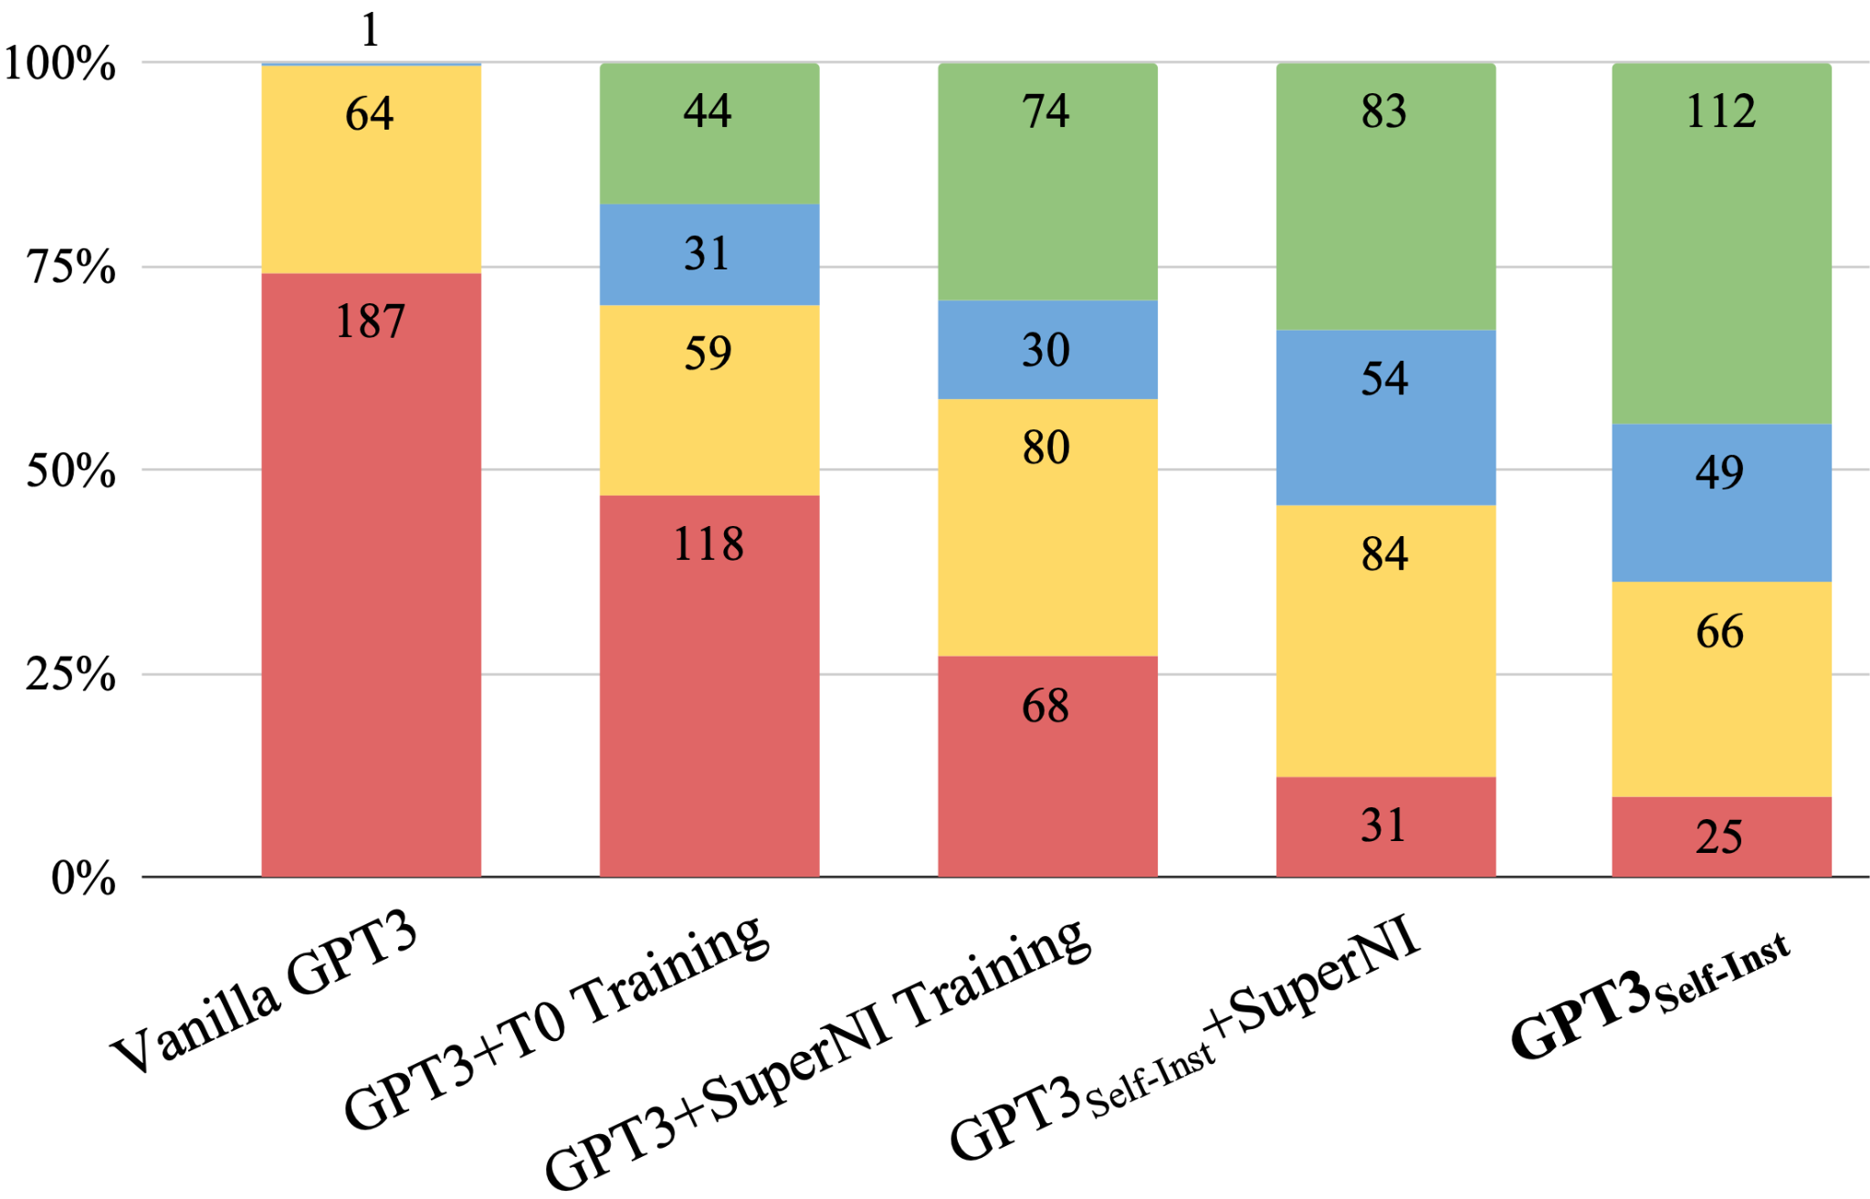
Evaluation on User-Oriented Instructions
[Self-Instruct: Aligning Language Model with Self-Generated Instructions, Wang et al. 2023]

Slide 35
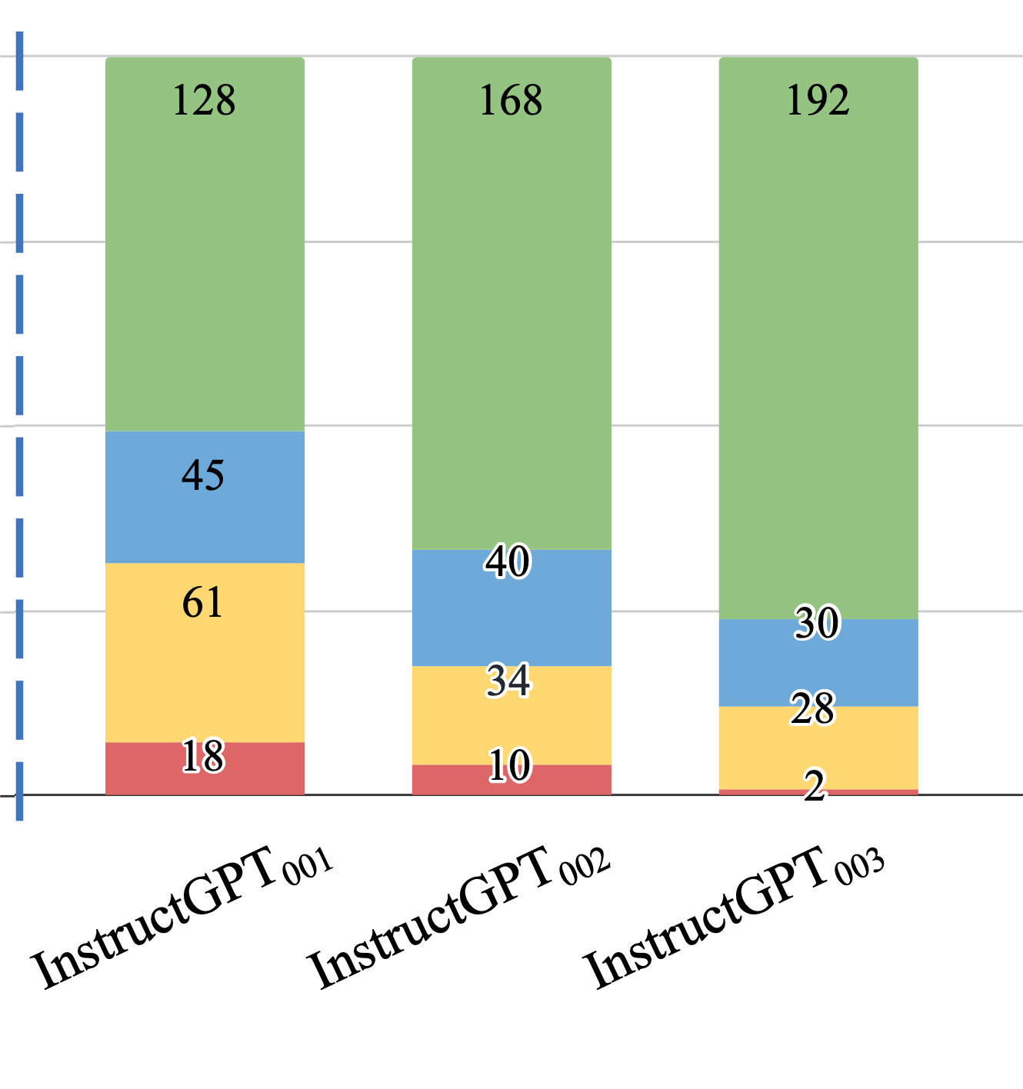
Evaluation on User-Oriented Instructions
LM pretraining
vanilla GPT3 (davinci)
+ instruct-tuning
GPT3-instruct (davinci-001)
Noisy, but diverse “self-instruct” data ~ thousands of clean human-written data
[Self-Instruct: Aligning Language Model with Self-Generated Instructions, Wang et al. 2023]

Slide 36
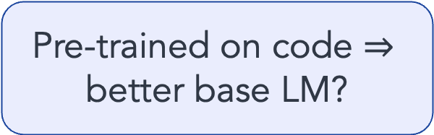
Evaluation on User-Oriented Instructions
LM pretraining
vanilla GPT3 (davinci)
+ instruct-tuning
GPT3-instruct (davinci-001)
+ code pre-training + instruct-tuning
GPT3-instruct (davinci-002)
Pre-trained on code $⇒$ better base LM?
[Self-Instruct: Aligning Language Model with Self-Generated Instructions, Wang et al. 2023]

Slide 37
Evaluation on User-Oriented Instructions
LM pretraining
vanilla GPT3 (davinci)
+ instruct-tuning
GPT3-instruct (davinci-001)
+ code pre-training + instruct-tuning
GPT3-instruct (davinci-002)
+ RLHF
ChatGPT
GPT3-instruct (davinci-003)
[Self-Instruct: Aligning Language Model with Self-Generated Instructions, Wang et al. 2023]

Slide 38
Summary Thus Far
Unclear whether RLHF is the best approach forward.
Data diversity seems to be necessary for building successful generalist models.
Though it is expensive to optimize for.
Mismatch between human expectation vs. pre-training
A contributor to their hallucination (?).
Self-Instruct:
Rely on creativity induced by an LLM’s themselves.
Applicable to a broad range of LLMs.
Several open-source models utilize “Self-Instruct” data.
(* See also concurrent work: Unnatural-Instructions [Honovich et al. 2022] and Self-Chat [Xu et al. 2023] )

Slide 39
But Wait a Sec …
So, we used LM to generate data for aligning itself??
Step #1:
Pre-train
Step #2/3: Align (RLHF or instruction-tune)
Notes:
But now that we have shown that,
Okay, so now how do you go about verifying or disproving this? (assuming that there is a winner). We need to formulate experiments that might give some clues regarding this question.
Suppose the first hypothesis is correct, that is, pre-training is carrying most of the weight. Pre-trained models effectively contained compressed knowledge of the world they just don't know how to articulate it. So, all that the post-processing step is doing is tweaking its parameters just slightly, so that the model knows how to articulate its pre-existing knowledge of the world.
With a show of hands ….

Slide 40
But wait a sec …
Fundamentally, what is the role of post hoc alignment (step #2/3)?
Teaching LM knowledge of new tasks?
Lightly modify LM so it can articulate its existing knowledge of tasks?
(+ put guardrails for what it can articulate)
Step #1:
Pre-train
Step #2/3: Align (RLHF or instruction-tune)
Notes:
But now that we have shown that,
Okay, so now how do you go about verifying or disproving this? (assuming that there is a winner). We need to formulate experiments that might give some clues regarding this question.
Suppose the first hypothesis is correct, that is, pre-training is carrying most of the weight. Pre-trained models effectively contained compressed knowledge of the world they just don't know how to articulate it. So, all that the post-processing step is doing is tweaking its parameters just slightly, so that the model knows how to articulate its pre-existing knowledge of the world.
With a show of hands ….

Slide 41
Implications for how cost it will be
Fundamentally, what is the role of post hoc alignment (step #2/3)?
Teaching LM knowledge of new tasks?
Lightly modify LM so it can resurface its existing knowledge?
(+ put guardrails for what it can articulate)
Identify what knowledge needs to be taught.
Make it more efficient, possibly with minimal human labor.
Step #1:
Pre-train
Step #2/3: Align (RLHF or instruction-tune)

Slide 42
Implications for what comes out
Fundamentally, what is the role of post hoc alignment (step #2/3)?
Teaching LM knowledge of new tasks?
Lightly modify LM so it can articulate its existing knowledge of tasks?
(+ put guardrails for what it can articulate)
It will be as good as the alignment supervision.
Unexpected behaviors may “emerge”.
Step #1:
Pre-train
Step #2/3: Align (RLHF or instruction-tune)
Notes:
These are different research trajectories.
My 2 cents is that, the latter is correct, which is why we went after Self-Instruct, however, we didn’t close the gap. So, I am not sure whether the reality is closer to this or this.

Slide 43
My 2 cents
Most of the heavy lifting is done via pre-training (unlabeled).
Alignment to “instructions” (tuning/RLHF) is a light touch on LLMs.
Can (and should) be done more efficiently and effectively.

Slide 44
There is a compromise between alignment with humans vs. remaining aligned to pre-trained observations
The more you force it toward humans, the more it’s going to hallucinate

Slide 45


RLHF is patchwork for lack of grounding
RLHF teach LMs (ground) the communicative intent of users.
For example, what is intended by “summarize”? The act of producing a summary grounded in the human concept of "summary”.
Not a panacea, but a short-term “band-aid” solution.
Intents and norms
RLHF or instruct-tuning
LM
[Some remarks on Large Language Models, Goldberg 2023]
Notes:
Increasingly that LMs are going to be deployed to interact with humans, the need for RLHF shrink is models will increasingly learn about their users’ intents.

Slide 46
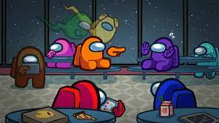
Alignment as a social process
Can alignment emerge as a social experience?
Notes:
What feels more natural to me is some sort of alignment as a social exercise.
By observing, by interaction and at times, failure. That is a very much a curiosity-driven learning.
By maximizing notions such as harmony or collective survival, like what evolution did to us.

Slide 47
Roadmap
Efficient Alignment
Mitigating hallucination
Wang et al. 2023
[ACL 2023]
Weller et al. 2023 [under review]
Notes:
I must confess, in none of these projects we study

Slide 48
Roadmap
Efficient Alignment
Mitigating hallucination
Wang et al. 2023
[ACL 2023]
Weller et al. 2023 [under review]
Notes:
I must confess, in none of these projects we study

Slide 49
Getting LLMs to cite their sources
Show difficulty of attribution in existing models
Bing or Google
How can we make progress toward LLMs with attribution?
A simple idea: “According to”
Why does it work?
Effect of data frequency
Effect of model scale
Effect of RLHF

Slide 50

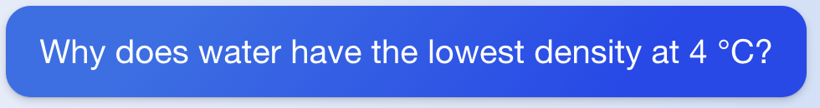
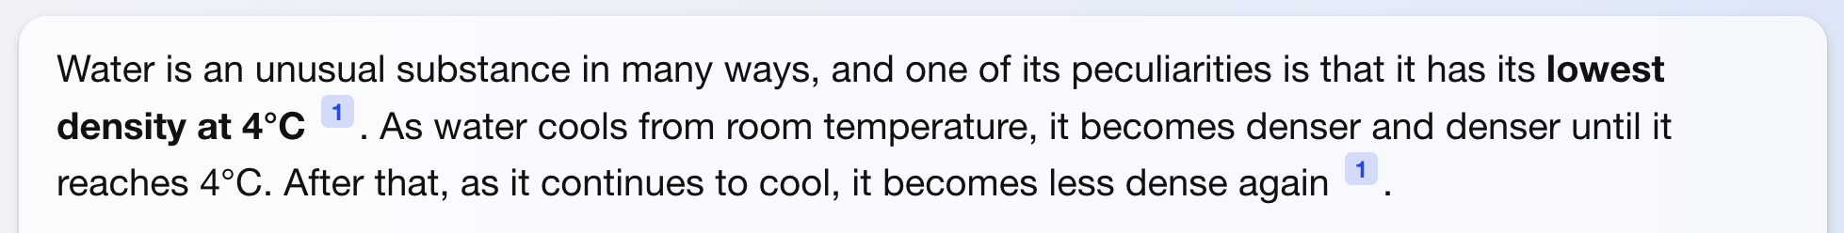
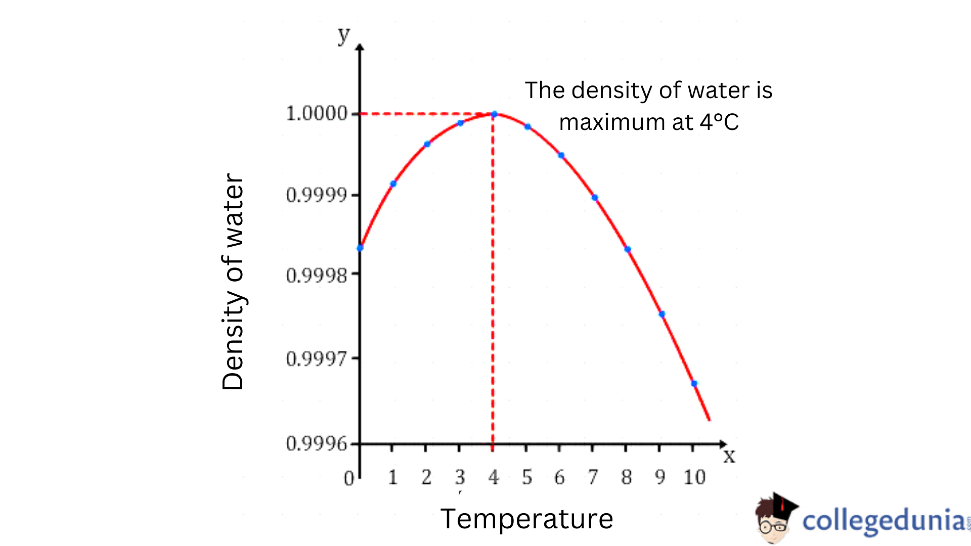
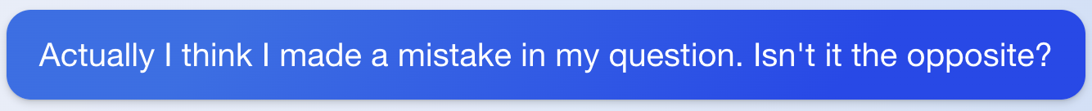
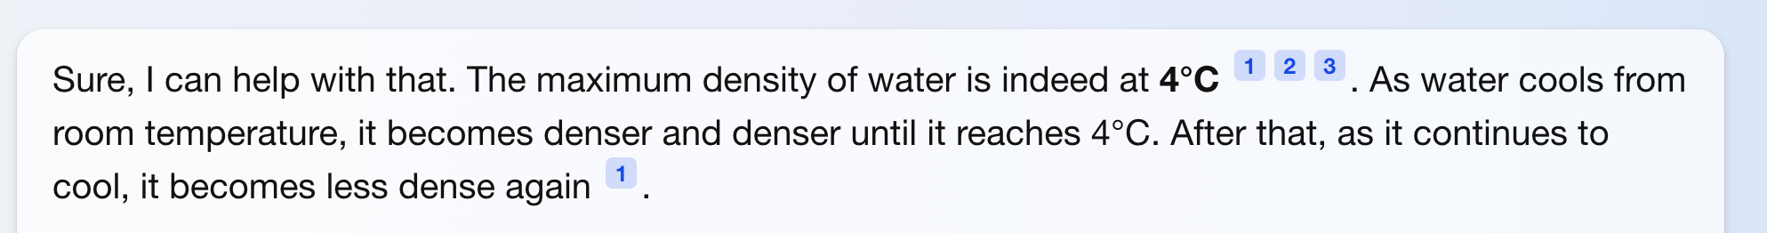
(fetched on Aug 30, 2023)

Slide 51
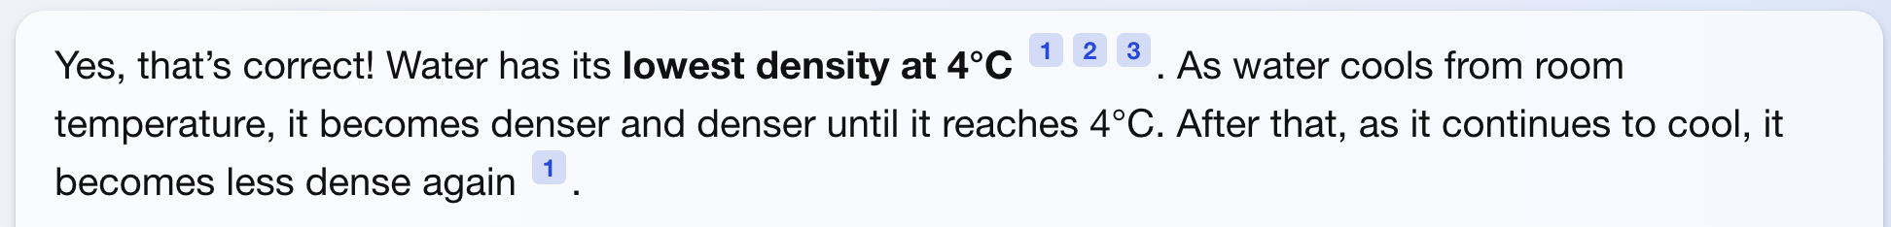

Slide 52
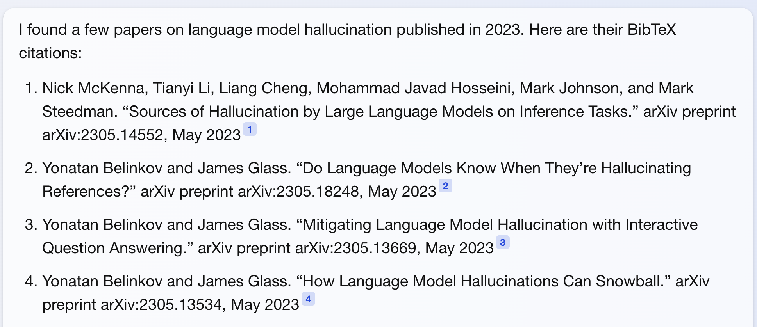
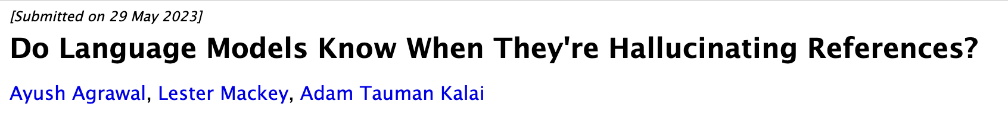
Real papers, made-up names!

Slide 53
Retrieval-augmented generation helps [Shuster et al. 2021], but it doesn’t solve the issue.
Notes:
…. So is there anything else we can do to reduce hallucination of language models and ground them in data that trust?

Slide 54

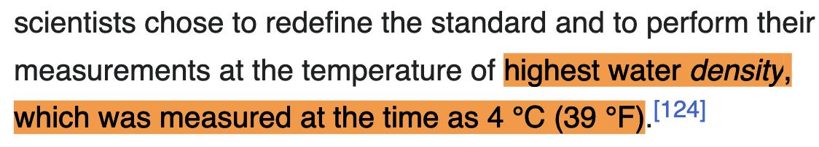
Associating knowledge and sources?
Do LLMs encode an implicit association of text form and the knowledge sources in their pre-training?
“highest water density, which was measured at the time as 4 °C”
LM
pre-training data
e.g., “Wikipedia”
Notes:
Instead, we consider is a slightly different hypothesis.

Slide 55





"According to ..." Prompting Language Models Improves Quoting from Pre-Training Data
Orion Weller, Marc Marone, Nathaniel Weir, Dawn Lawrie, Daniel Khashabi, Benjamin Van Durme
https://arxiv.org/abs/2305.13252

Slide 56

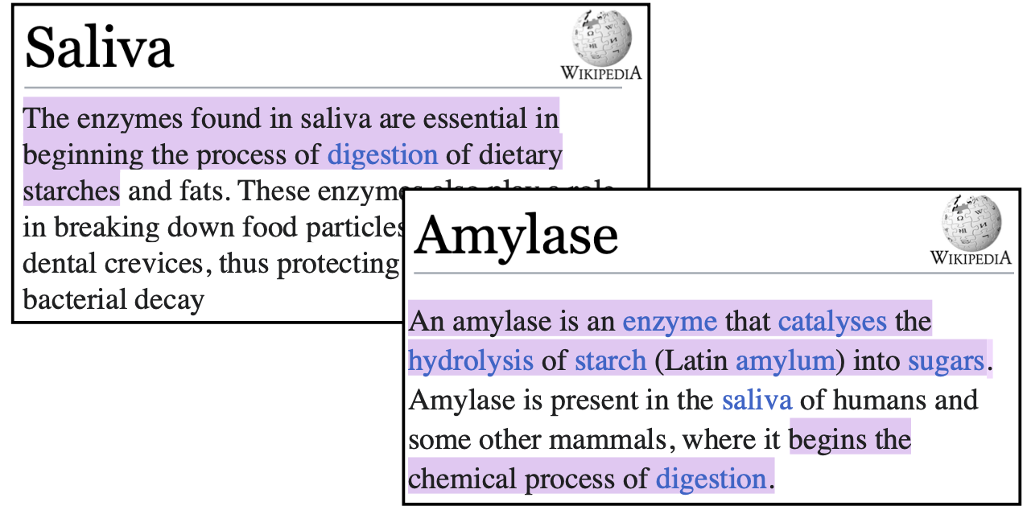
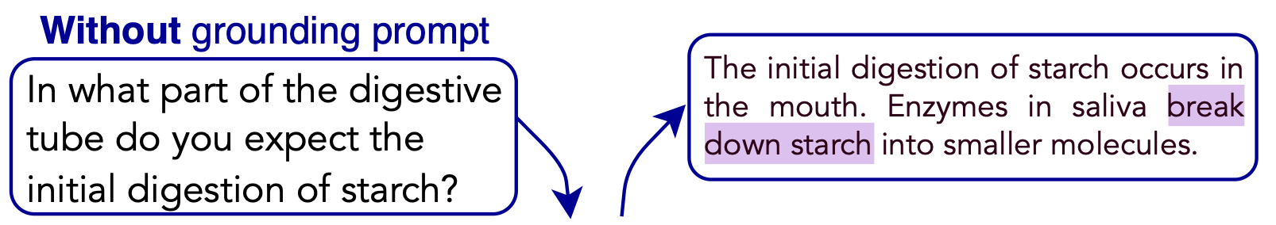
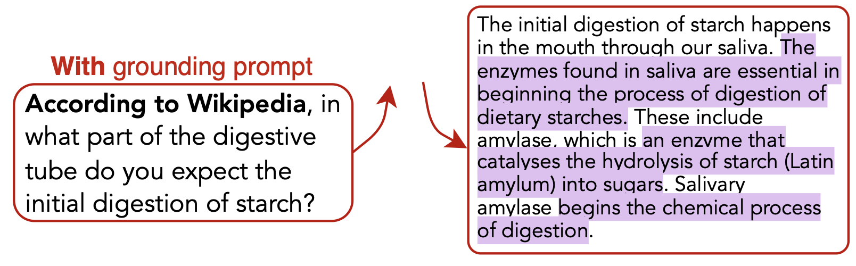
Do LLMs encode an implicit association of text form ⇔ the knowledge sources in their pre-training?
quotes
LM

Slide 57
Challenge: How can we measure “quoting” from a given large corpus?
quotes
LM

Slide 58
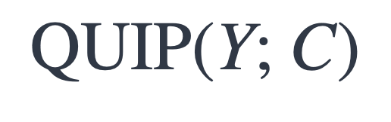
Measuring Quoting
generated text
A large corpus
$$\text{QUIP}\text{(}\text{Y}\text{; }\text{C}\text{)}$$
[“According to . . . ” Prompting Language Models Improves Quoting from Pre-Training Data, Weller and Marone, et al. 2023]

Slide 59
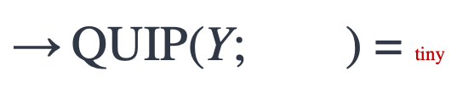

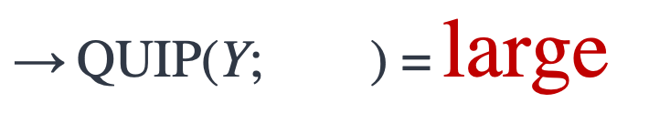
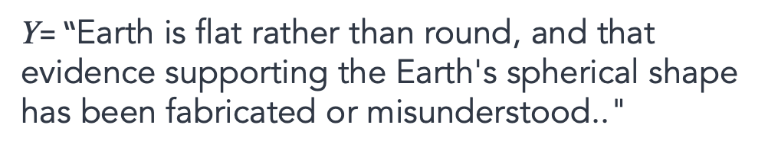
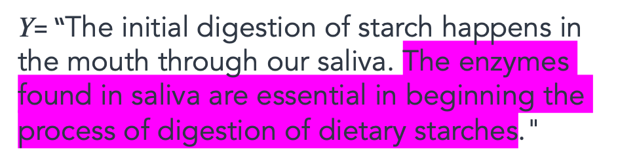
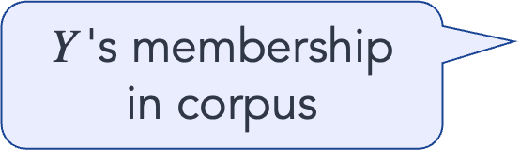
Measuring Quoting
generated text
A large corpus
$\text{Y}$'s membership in corpus
$$\text{QUIP}\text{(}\text{Y}\text{; } \text{)}$$
$\text{Y}$= “The initial digestion of starch happens in the mouth through our saliva. The enzymes found in saliva are essential in beginning the process of digestion of dietary starches."
$\text{→} \text{QUIP}\text{(}\text{Y}\text{; } \text{)}\text{ =}$ $\text{large}$
$\text{Y}$= “Earth is flat rather than round, and that evidence supporting the Earth's spherical shape has been fabricated or misunderstood.."
$\text{→} \text{QUIP}\text{(}\text{Y}\text{; } \text{)}$ = tiny
[“According to . . . ” Prompting Language Models Improves Quoting from Pre-Training Data, Weller and Marone, et al. 2023]

Slide 60
Measuring Quoting
generated text
A large corpus
QUIP is based on “Data Portraits” [Marone and Van Durme. 2023]
Artifact for documenting data
Fast membership query (whether a string belongs to your data)
Implemented via Bloom filter — it is not a bit noisy, but scalable.
$\text{Y}$'s membership in corpus
$$\text{QUIP}\text{(}\text{Y}\text{; } \text{)}$$
[Data Portraits: Recording Foundation Model Training Data, Marone and Van Durme 2023]

Slide 61
LLMs can be steered to quote
Without grounding prompt
In what part of the digestive tube do you expect the initial digestion of starch?
With grounding prompt
Answer according to Wikipedia:
In what part of the digestive tube do you expect the initial digestion of starch?

Slide 62
LLMs can be steered to not quote
Without grounding prompt
With anti-grounding prompt
In what part of the digestive tube do you expect the initial digestion of starch?
Respond without using Wikipedia :
In what part of the digestive tube do you expect the initial digestion of starch?
With grounding prompt
Answer according to Wikipedia:
In what part of the digestive tube do you expect the initial digestion of starch?
Respond using information from Github:
In what part of the digestive tube do you expect the initial digestion of starch?

Slide 63
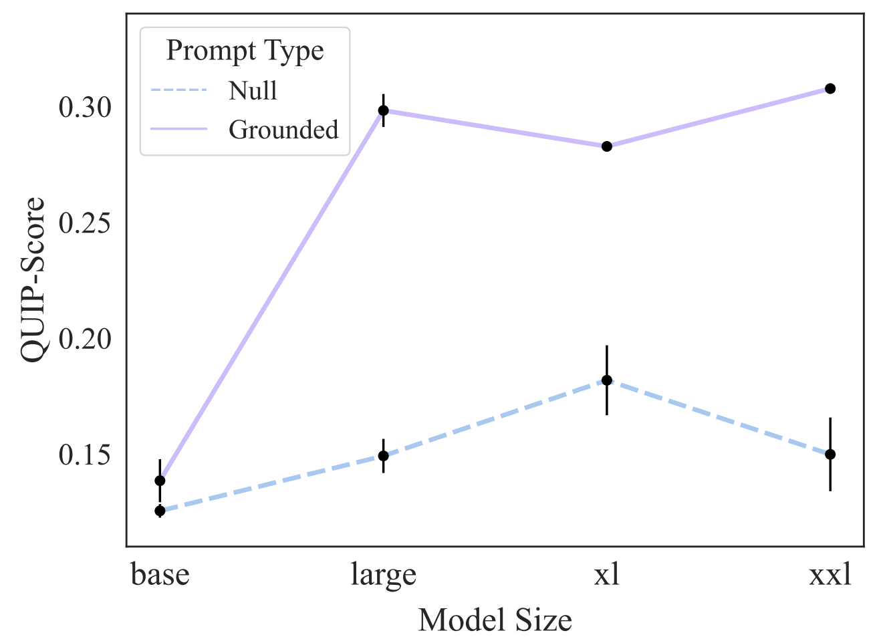
As models scale, so does their ability to quote!

Slide 64
Summary Thus Far
LLMs learn to associate text form to knowledge sources.
LLMs are steerable to quote from known sources in their pre-training.
More experiment (more prefixes, domains, etc.) in our paper.
This serves an additional mechanism to reduce hallucination.
Though the challenge remains wide open.
Why exactly this happens requires more work.
Notes:
…
Why does it work?
Effect of data frequency
Effect of model scale
Effect of RLHF

Slide 65
Looking forward

Slide 66
Back to the big picture
We are starting to perfect a single round of c
But we don’t know how to close the loop.
The issue is that “loop” has many prerequisites.

Slide 67
Interaction remains challenging
Lots of progress in single round of communication.
But we don’t know how to close the loop.
The issue is that “loop” has many prerequisites.
We need to be able to engineer systems such that they:
Adaptively change to our needs;
Seamlessly pick up on our implicit demands;
Reliable interaction with the world (web, physical world, etc.);
Respect norms and social harmony;
….
Notes:
And it is not clear whether paradigms such as RLHF is really going to address all these issues.

Slide 68
Exponential or logarithmic?
It seems like a lot change all of a sudden.
Some argue that we’re on an exponential growth path.
Evidence suggests that we’re on a logarithmic path.
Diminishing returns w/ scaling compute, data, human supervision, etc.
The thing that been exponential is our (companies) appetite in expanding their GPU clusters.
Notes:
The only thing that has

Slide 69
Train/Test Split Does Not Work Anymore
With our planetary-level pre-training, the train-test evaluation protocol is no more viable. How should we revise it?
Most LM papers:
My 2 cents: evaluation on planetary-scale time-stamped data.
“… after pre-training, we noticed a leakage … “
t'
t
time
Notes:
It’s easy to blame these papers, but actually we maybe shouldn’t.
At some point in the past, you can’t use anything on the planet to train on.
– internet, humans, etc. anything …
-

Slide 70

Intelligence Continues to be a Moving Target
Every step forward, we realize there are new challenges.
Unless there is a revolution outside AI (energy, hardware, etc.), we need a lot more innovations.

Slide 71
Thanks!

Slide 72
End with open questions:
Role of RLHF and its necessity
Other aspects that we can’t capture
Curiosity
Altruism
…

